Slide 1

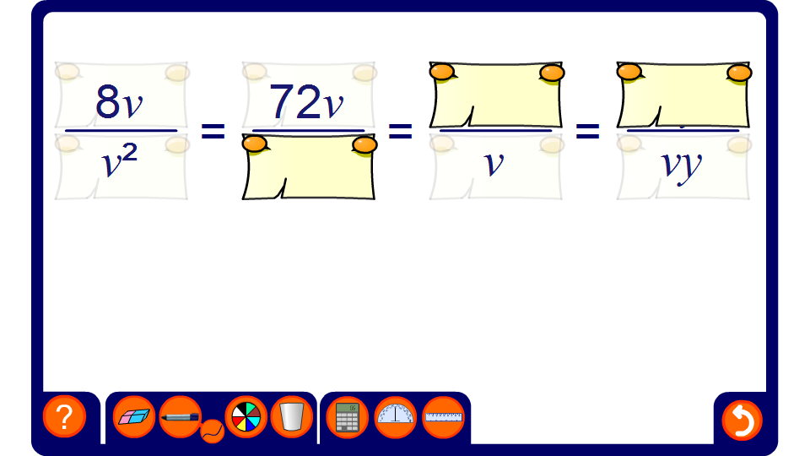


Equivalent algebraic fractions
Notes:
It is important to realize that, like numerical fractions, multiplying or dividing the numerator and the denominator of an algebraic fraction by the same number, term or expression does not change the value of the fraction. This fact is used both when simplifying algebraic fractions and when writing algebraic fractions over a common denominator to add or subtract them.

